Slide 1
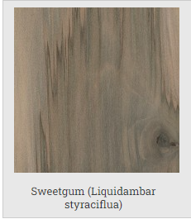
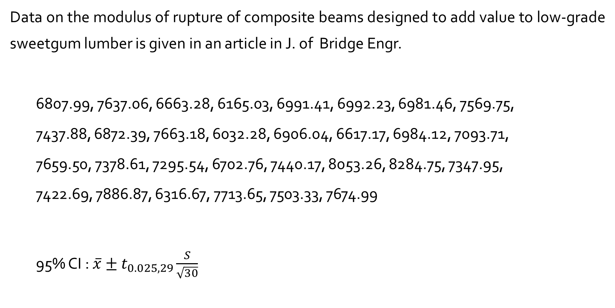
The One-Sample $t$ Confidence Interval : Example 7.11
Data on the modulus of rupture of composite beams designed to add value to low-grade sweetgum lumber is given in an article in J. of Bridge Engr.
6807.99, 7637.06, 6663.28, 6165.03, 6991.41, 6992.23, 6981.46, 7569.75,
7437.88, 6872.39, 7663.18, 6032.28, 6906.04, 6617.17, 6984.12, 7093.71,
7659.50, 7378.61, 7295.54, 6702.76, 7440.17, 8053.26, 8284.75, 7347.95,
7422.69, 7886.87, 6316.67, 7713.65, 7503.33, 7674.99
95% CI : $\overline{x}±t_{0.025,29}\frac{S}{\sqrt{30}}$

Slide 2
modulus <- c(6807.99, 7637.06, 6663.28, 6165.03, 6991.41, 6992.23, 6981.46, 7569.75, 7437.88, 6872.39, 7663.18, 6032.28, 6906.04, 6617.17, 6984.12, 7093.71, 7659.50, 7378.61, 7295.54, 6702.76, 7440.17, 8053.26, 8284.75, 7347.95, 7422.69, 7886.87, 6316.67, 7713.65, 7503.33, 7674.99)
95% confidence interval :
> mean(modulus) + c(lower=-1, upper=+1) * qt(0.975,29)*sd(modulus)/sqrt(length(modulus))
> lower upper 7000.230 7406.152
> t.test(modulus)
95 percent confidence interval:
7000.230 7406.152

Slide 3
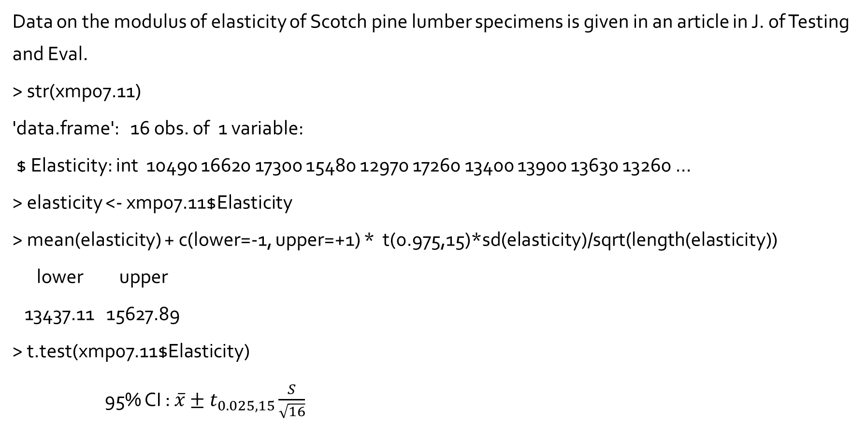
Example of confidence interval on $μ$ : Example 7.14
Data on the modulus of elasticity of Scotch pine lumber specimens is given in an article in J. of Testing and Eval.
> str(xmp07.11)
'data.frame': 16 obs. of 1 variable:
$ Elasticity: int 10490 16620 17300 15480 12970 17260 13400 13900 13630 13260 ...
> elasticity <- xmp07.11$Elasticity
> mean(elasticity) + c(lower=-1, upper=+1) * t(0.975,15)*sd(elasticity)/sqrt(length(elasticity))
lower upper
13437.11 15627.89
> t.test(xmp07.11$Elasticity)
95% CI : $\overline{x}±t_{0.025,15}\frac{S}{\sqrt{16}}$

Slide 4
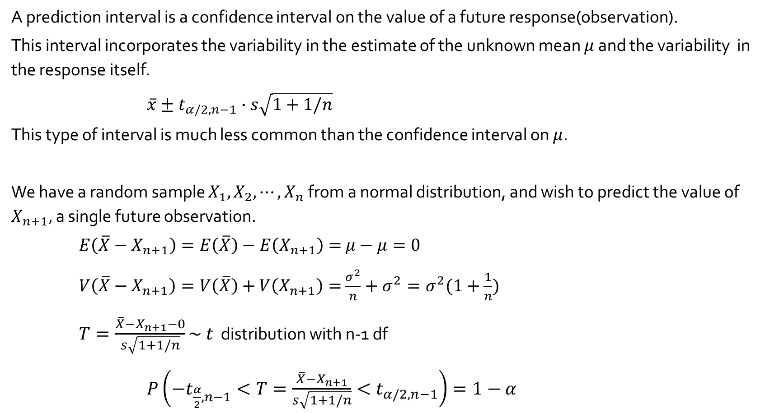
Prediction
A prediction interval is a confidence interval on the value of a future response(observation).
This interval incorporates the variability in the estimate of the unknown mean $μ$ and the variability in the response itself.
$\overline{x}±t_{α/2,n−1}∙s\sqrt{1+1/n}$
This type of interval is much less common than the confidence interval on $μ$.
We have a random sample $X_{1}, X_{2}, ⋯,X_{n}$from a normal distribution, and wish to predict the value of $X_{n+1},$a single future observation.
$E\left(\overline{X}−X_{n+1}\right)=E\left(\overline{X}\right)−E\left(X_{n+1}\right)=$ $μ−μ=0$
$V\left(\overline{X}−X_{n+1}\right)=V\left(\overline{X}\right)+V\left(X_{n+1}\right)=$ $\frac{σ^{2}}{n}+σ^{2}=σ^{2}(1+\frac{1}{n})$
$T=\frac{\overline{X}−X_{n+1}−0}{s\sqrt{1+1/n}}\sim t$ distribution with n-1 df
$P\left(−t_{\frac{α}{2},n−1}<T=\frac{\overline{X}−X_{n+1}}{s\sqrt{1+1/n}}<t_{α/2,n−1}\right)=1−α$

Slide 5
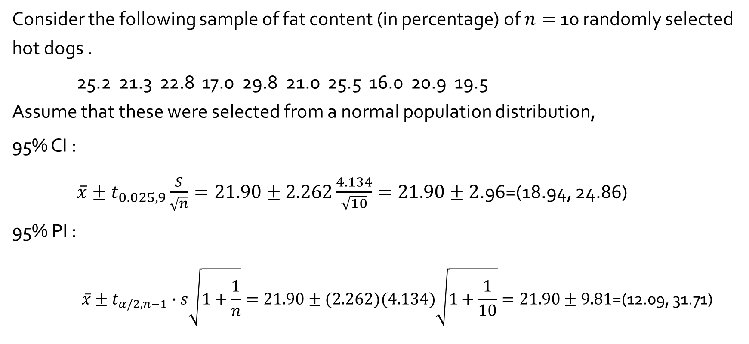
Example 7.12, 7.13
Consider the following sample of fat content (in percentage) of $n=$ 10 randomly selected hot dogs .
25.2 21.3 22.8 17.0 29.8 21.0 25.5 16.0 20.9 19.5 Assume that these were selected from a normal population distribution,
95% CI :
$\overline{x}±t_{0.025, 9}\frac{S}{\sqrt{n}}=21.90±2.262\frac{4.134}{\sqrt{10}}=21.90±2$.96=(18.94, 24.86)
95% PI :
$$\overline{x}±t_{α/2,n−1}∙s\sqrt{1+\frac{1}{n}}=21.90±(2.262)(4.134)\sqrt{1+\frac{1}{10}}=21.90±9.81\text{=(}\text{12.09, 31.71}\text{) }$$

